Slide 1
ENVIRONMENTAL HEALTH
UNIT OBJECTIVES
types of environment
biological
physical
political
economic
food safety and hygiene
water and sanitation
housing

Slide 2
CONT……………………….
waste and excreta disposal
air and ventilation
pollution
public health act
control of vector and pests
social cultural factors that affect health

Slide 3
ENVIRONMENTAL HEALTH
DEFINITION
Environmental health is the branch of public health that is concerned with all aspects of the natural and built environment that may affect human health. Wikipedia.

Slide 4
Environmental Health Officers
(Also known as Public Health officers)
Responsible for carrying out measures for protecting public health, including administering and enforcing legislation related to environmental health and providing support to minimize health and safety hazards.

Slide 5
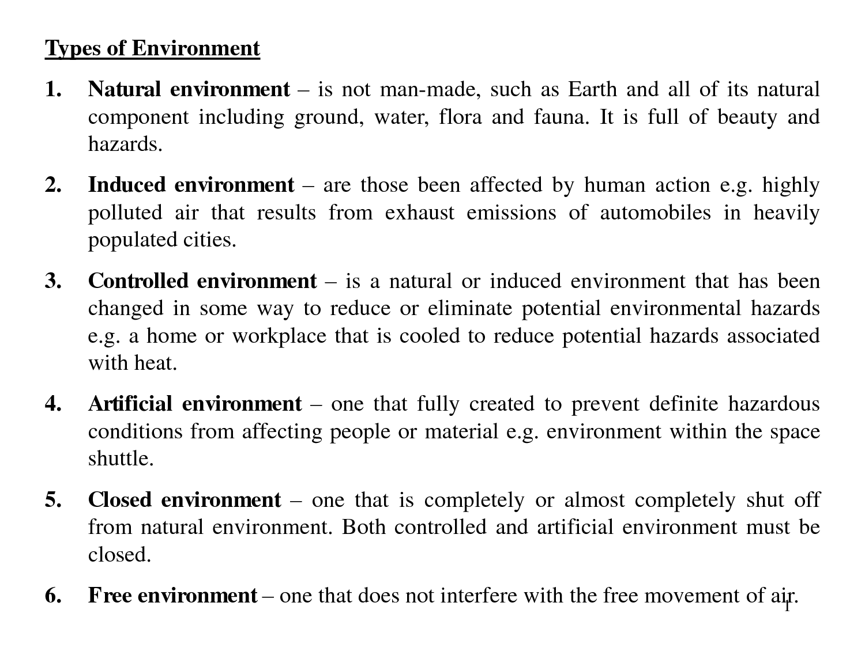
ENVIRONMENT TYPES
Notes:
Flora –plants of an area,the environment type or period of time- fauna-animals –flora and fauna—plants and animals

Slide 6
PUBLIC HEALTH ACT
CAP 242 (revised- 2012—from 1986)
Commencement was 6th sept 1921
Go to- www.kenyalaw.org
Or Google public health Act.
It is an act of parliament to make provision for securing and maintaining health
(Students to read on the act)

Slide 7
PERSONAL HYGIENEOBJECTIVES (BY THE END OF THE SESSION)
Define personal hygiene
Explain importance of maintaining P/H
Describe the factors involved in maintenance of P/H
Analyze conditions which occur due to poor hygiene

Slide 8
HYGIENE
Hygiene is the study of health and observance of health rules.
Study methods and means of preserving health.
Hygiene is classified into two:-
Personal hygiene.
Communal hygiene.

Slide 9
PERSONAL HYGIENE
It’s a branch of hygiene which deals with health maintenance in the individual in order to safe guard his own health and the health of others.
By knowing and practicing the rules of hygiene and sanitation and adhering to the principles of good health and living

Slide 10
PRINCIPLES OF GOOD HEALTH AND LIVING
Preventive or prophylactic measures.
Appropriate waste disposal.
Maintenance of body cleanliness.
Water treatment.
Immunization.
Aspect of diet or food safety.

Slide 11
2) PROMPT CARE WHEN INJURIES OR ILLNESS DEVELOP
Personal health is the responsibility of each individual who should be able to keep himself physically fit so that one can make the greatest contribution to the community he/she is in.

Slide 12
IMPORTANCE OF MAINTAINING PERSONAL HYGIENE TO HEALTH
Personal hygiene contributes to health in several ways:-
It protects the individual against disease germs that are present in the environment.
It protects the family by reducing the spread of disease germs.

Slide 13
CONT……………………….
3. It promotes health-
This is a state of maximum, physical, mental(Psychological), social, spiritual well being and not merely the absence of disease or infirmity.
4. It promotes morale.
An individual will confidently face the others.
Notes:
Morale –confidence and enthusism

Slide 14
MEASURES TO PROTECT AND IMPROVE HEALTH
Personal cleanliness.
Care of mouth and teeth.
Care of gut.
Food and drink.
Rest and recreation.
Protection against elements such as heat, cold, rain and wind.

Slide 15
CONT……………..
7). Protection against disease carrying insects.
8). Avoidance of sources of the disease such as ensuring that water is treated.
9). Proper disposal of waste to prevent environmental contamination.
10). Special protective measures such as wearing protective clothing depending on the environment we are in.

Slide 16
NOTE
There is need to cultivate a healthy mind and companionship.
The individual needs to participate in group activities in order to avoid concentrating on personal depressing problems or feelings so as to keep a health mind.

Slide 17
PERSONAL CLEANLINESS
We should keep our body and clothing clean.
SKIN
The skin as an extensive and important organ containing many nerve endings, glands and blood vessels.
A healthy skin be firm, supple (shiny) and elastic.
Cleanliness of the skin is very important for a lot of dirt collect in the skin surface.

Slide 18
CONT…………………
This dirt is composed of :
Dried sebum.
Solids that are left by the evaporated sweat.
Dust from environment.
Micro-organisms.
Epithelial scales.

Slide 19
CONT…………..
If not washed out-the above will clog the pores of the secreting glands
In order to maintain the cleanliness of the skin, we need to have daily baths (warm or cold baths)
We should clean our bodies with soap because soap removes dirt because of its alkaline nature which forms an emulsion with the oily sebum and the dirt is washed off with water.

Slide 20
ADVANTAGES OF WARM BATHS
The recommended temperature is 38⁰c or 100⁰F.
Warm baths are refreshing and have a sedative action due to the soothing effect on the nerve endings.
Regulation of temperature.
Opening of the spores.
Relieve of cough illness-eliminates phlegm-the cause of irritation.
Accelerates blood circulation-avoiding migraine.
Relieve of stress.
Keep the skin moist and lubricated.

Slide 21
BENEFITS OF COLD BATH
Improved blood circulation
Increases testosterone
Increases energy and well being
Strengthens immunity

Slide 22
STRUCTURES OF THE SKIN
This was covered in anatomy and physiology
Students need to revise on the skin
Draw and label the diagram of the skin

Slide 23
NOTE………………………
We are supposed to take adequate and well balanced diet in order to maintain an healthy skin.
Especially if there is an injury.
New cells develop and there is repair of the damaged ones.

Slide 24
Functions of the skin
Will be covered later but students can revise their anatomy and physiology notes

Slide 25
SOME EFFECTS OF UN CLEANLINESS
Skin diseases e.g. acne, scabies, ring worms, pediculosis.
Lice (Pediculosis).
Bed bugs.
Fleas.
Bad smell-oral.
Dental caries.

Slide 26
CLEANLINESS OF THE HEAD/HAIR
Proper care of the hair and daily brushing.
Shampoo at frequent intervals for moisturizing and blood supply.
Fresh air is also required for the hair.

Slide 27
HAND /NAILS
Hands Kept clean every time free from cracks and roughness.
These occur due to exposure to cold wind, use of antiseptics and manual work.
Nails should be cut short in a curve manner.

Slide 28
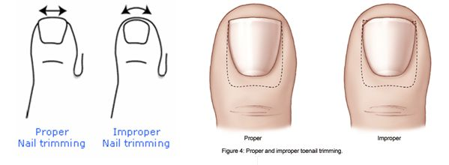
NAIL TRIMMING

Slide 29
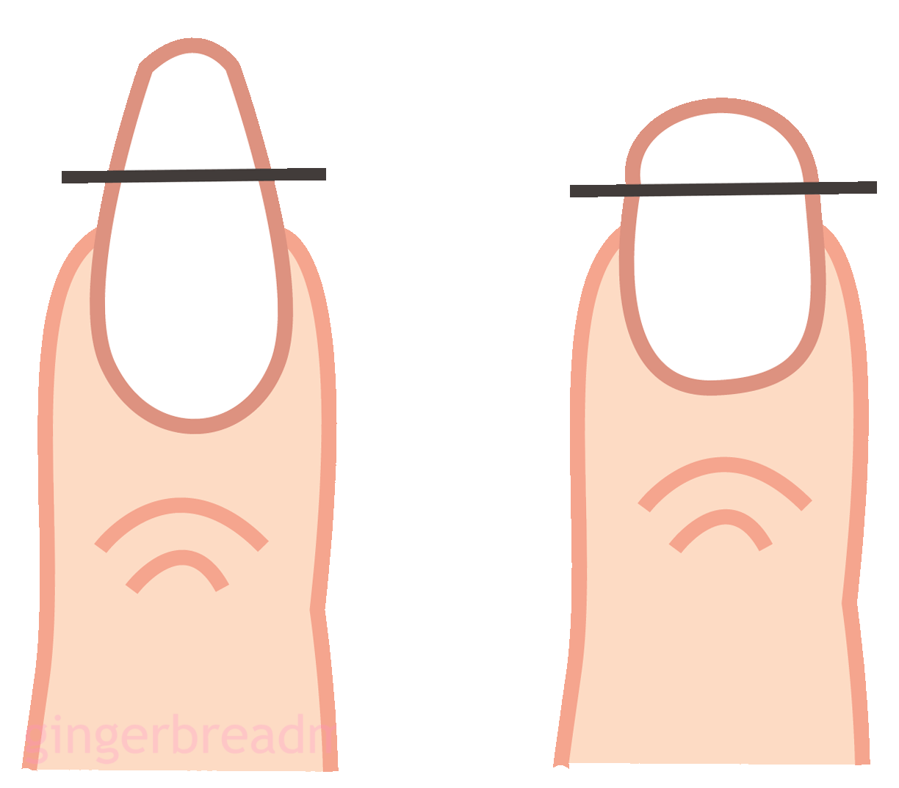
CONT……….
nails

Slide 30
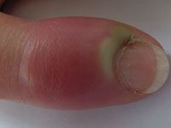
CONT…………………………..
Nurses should not have pointed or painted nails.
Can injure the pt and self.
Micro-organisms can be harbored by them.
Infection can set in if poorly cut- Paronychia.

Slide 31
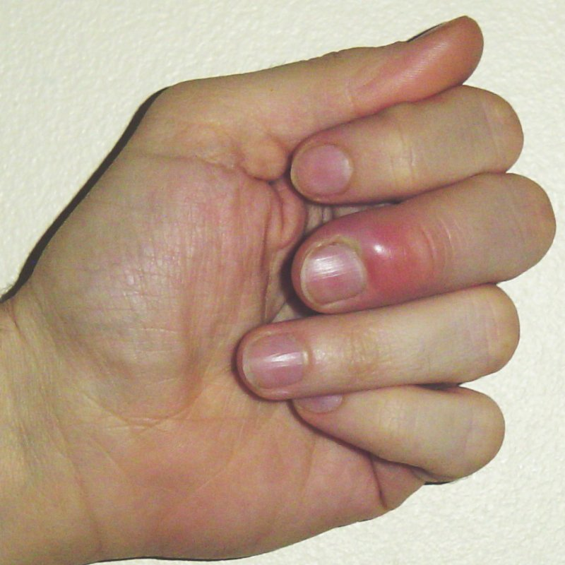
PARONYCHIA

Slide 32
CONT……………….
It is advisable to apply glycerin or Vaseline to the palms and hands
Wash hands and nails frequently with soap and water.
When should we was hands?
Notes:
Before and after every nursing procedure

Slide 33
THE FEET
Clean feet daily and dry them thoroughly especially between the toes.
Sweat glands in the feet are many and many people have excessive sweating a condition called hyperhydrosis.
This is offensive to some and can also cause soreness.
Socks should be cleaned every day and cleaning feet at least twice per day.

Slide 34
CONT……………………..
Change socks & stockings frequently and no re-using
Some people apply spirit and deodorants which encourage evaporation
Shoes should be dusted daily and aired-also clean inside
Using of nice inner soles which can be washed daily is recommended

Slide 35
SOME PROBLEMS THAT OCCUR IF FEET IS NOT CLEANED WELL
Corns –from ill fitting shoes.
Callosities-caused by pressure and friction of the under surface.
Bunions –due to wearing sharp pointed shoes (see diagram next slide).
Notes:
Corn –a local hardening—occuring from ill fitting shoes
Callosites-the plaques of hardening feet or palms

Slide 36
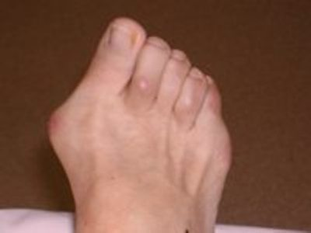
BUNION

Slide 37
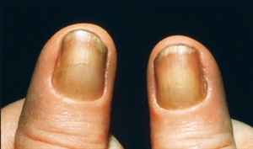
HYPERTROPHIED NAILS (ONYCHAUXIS)
Hard thick nails mostly resulting in injuries

Slide 38
PREVENTION OF THE ABOVE PROBLEMS
Wear comfortable shoes which are well fitting and don’t clamp the toes
Leather shoes are the best because for they are porous and allow air circulation
They are also easy to clean
The inner part should be firm and soft
Heels should be low to avoid throwing the weight of the body ahead

Slide 39
THE NURSE’S SHOE
Laced shoes are the best because they provide better support
A medium heel tipped with rubber is advocated to help in quick and quiet walking
Have at least 2 pairs –to alternate in wearing

Slide 40
CARE OF MOUTH AND TEETH
If mouth is not cleaned, it can become infected and the tongue can develop sores and bad smell
Prevention
Clean mouth in the morning and evening and if possible after each meal
Use an effective tooth brush or the traditional sticks or roots
Use up and down movements and also circular movements

Slide 41
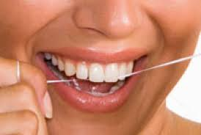
CONT…………………………….
Avoid side ways and vigorous brushing
One can use dental floss because tooth brush can not remove all the food remains
DENTAL FLOSS

Slide 42
CONT……………………..
Accumulated food particles will cause decay and makes micro organisms attack the gum and teeth causing dental caries(teeth decay)
this leads to insufficient chewing and thus ill health.
Infected teeth can spread infections to other parts of the body
One can also use saline water for teeth care and gaggling too.

Slide 43
BENEFITS OF GOOD ORAL HYGIENE
Prevention of mouth diseases e.g. stomatitis, gingivitis , dental caries etc.
Improves self image
Promotes digestion
Gives pleasure in eating-taste of food
Good health teeth enhance speech
Cutting of cost-dental care

Slide 44
FACTORS THAT AFFECT OUR HEALTH
Exercises
Physical exercise are essential for health to be maintained
Recreation
Rest and sleep
Posture
Habit formation
Includes good and bad habits

Slide 45
NUTRITION
Nutrition can be defined as the study of food and how our bodies use food
Main food groups
Proteins
Carbohydrates
Fats and oils
Vitamins and minerals
water

Slide 46
ROLE OF FOOD IN THE BODY
To provide energy, necessary for warmth and functioning of the body e.g. the heart requires energy to work, muscles to move etc
Energy foods include-carbohydrates, fats and oils
2). Foods to build new cells and tissues- e.g. cells of the muscles replace worn out tissue or cells
Foods rich in proteins include fish, eggs, milk, beans, meat etc

Slide 47
CONT…………………..
3). Protection-protecting the body against diseases and facilitating assimilation and use of other nutrients, vitamins and minerals e.g. vegetables and fruits
4). Constituents-
It is involved in preparing hormones e.g. insulin, thyroxine etc
Many foods belong to two categories –e.g. beans-provide proteins and carbohydrates

Slide 48
CONT…………………………….
Some foods may be categorized but there is no single food that provides sufficient nutrients for growth and maintenance of the body.
Therefore a proper diet is a mixed diet from 3 main groups.
Food provide enjoyment, since eating and drinking are among pleasures of life.
Food nourishes the body and the soul, this is by adding flavors to the food.

Slide 49
PROTEINS
Healthy adults require proteins for wearing out and repair.
Healthy infants and children for growth
Pregnant women require extra proteins for repair and for the fetus.
Breastfeeding mothers require extra proteins for the baby and repair.

Slide 50
CONT……………………..
Sick adults require extra proteins because of worn out cells
Sick children require proteins for worn out cells, growth and development.

Slide 51
PROTEIN CONTENT IN FOOD
Most foods are a mixture of nutrient and contain water even if they look dry.
Many foods have a lot of one nutrient and a little of other nutrients.
Foods are called after the nutrient there is most- i.e. if a lot of protein-protein foods-etc—carbohydrates and fats –energy foods.
Vitamins and minerals-protective foods
some foods hardly contain any food nutrient e.g. soda.
Notes:
Nutrient –is a substance that is need to keep a living thing alive and to help it to grow

Slide 52
PLANT FOODS WHICH GIVE PROTEINS
1)-legumes
E.g. soya, beans, green grams, etc-when dry they contain 20-30% proteins-soya & beans 34%.
2)-Good staple food
Maize, wheat, millet,
Protein content-8-10 %-they are foods of grass family.
Notes:
Staple –forming a basic or important part of sth

Slide 53
CONT…………………….
3)-dark green leaves-
Spinach, sukuma wiki, pumpkin leaves (3-7%).
4)-Poor staple food-
Roots forming e.g. yams, bananas, cassava etc-
Protein content -1%.

Slide 54
CONT………………………
5).Animal food protein
All foods from animals give proteins except butter(fat from milk)-
Some animal foods contain more proteins than others e.g.
breast milk.
fish(all types)-63%.
Meat (all types- cow, goat pig monkey mice.
chicken –eggs.
insects- e.g. grass hoppers.

Slide 55
AMINO ACIDS
Proteins are made from amino acids-body makes some amino acids but have 8 amino acids the body cant make
The amino acids made by the body are called essential amino acids
Those it cant make are-non essential amino acids
The essential amino acids are to be eaten in food-protein-e.g. methionine, lysine, leucin.

Slide 56
REFERENCE PROTEINS
Mothers milk and eggs protein provide protein whose amino acids are perfect for body building
These proteins are therefore used as a reference to compare the usefulness of other proteins for body building e.g.
Maize contains very little amino acid-lysin but it has enough methionine amino acids
Peas have more lysin than methionine.

Slide 57
NET PROTEIN UTILIZATION (NPU)
A measure of the quality of a food.
NPU means the amount to which proteins are used for body building.
Eggs and mothers milk have an NPU of 100%.
Proteins that are only partly used for body building have an NPU of less than 100%.

Slide 58
CONT………………………..
Maize e.g. has an NPU of 55%
Animal proteins have a higher NPU than plants
E.g. –fish-83% and soya -56%

Slide 59
OVERVIEW
The food category depends on the nutrient which contains in higher quantities (the most in food).
When teaching on nutrition start with proteins because they cannot be substituted.
The grass family carbohydrates are more superior than root.
Irish potatoes superior than sweet potatoes –if not peeled.
Use real teaching aids/food items.

Slide 60
METHODS OF FOOD STORAGE AND COOKING
Vegetables
The term vegetables includes some fruits e.g. tomatoes, pumpkins
Leafs such as sukuma and cabbage
Roots such as carrots, flowers such as cauliflower
Vegetables are nearly eaten soon after they are harvested and not stored for long periods

Slide 61
CONT……………………….
Good habit to have a kitchen garden
Some vegetable grow wild in rural areas
Pumpkins can be stored for several months with little loss of nutrients
Tomatoes and vegetables may be stored but loose some vitamins.

Slide 62
CONT………………………
Prolonged cooking lowers vitamin C content.
Cook for 20 minutes only.
Many vegetables contain enzyme oxidase which becomes active when vegetable is cut or bruised.
The enzyme is not active if vegetables are intact.
Oxidase enzyme destroys vitamin C.

Slide 63
PREPARATION OF VEGETABLES
Preferably picked fresh from garden.
Wash in running water, avoid soaking cut vegetable.
Don’t leave cut vegetables for long.
Cook for 20 minutes not to destroy vitamin C
Plant vegetable in our small gardens –even sacks
Waste water can be utilized

Slide 64
FRUITS
Some fruits grow wild while others are planted
The main nutrient value of fruits is vitamin C
Fruits such as avocado and a few others fat, proteins or starch.
Fruits may not be stored for long.
Prolonged storage and cooking can make them loss some nutrients.

Slide 65
PREPARATION FOR STORAGE OF FRUITS
Wash fruits and remove skin and seeds.
For every 5 kilos of fruits use 3 kg of sugar.
Place in a cooking pot and add water to cover fruits.
Simmer for one hour and allow to cool
Put in a container with a lid/cover –well fitting.

Slide 66
CEREALS(MAIZE, MILLET, SORGHUM, RICE)
Highly milled products-can be stored better.
Low fat content reduces chance for unpleasant smell and low vitamin content makes it less attractive to insects and pests.

Slide 67
CONT…………………..
The dried seeds can be kept/stored
Variety such as maize are liable to be attacked by weevils and other insects
Pesticides can be used to prevent attack by weevils
Avoid excess pesticides so as to keep the food safe for consumption

Slide 68
CONT…………………….
Cereals must be washed thoroughly to remove the pesticide
Excess water can be removed to cook other foods e.g. soup or rice

Slide 69
STARCH ROOTS
May not be stored for long like the cereals-just a few months
Prolonged cooking should be avoided
Excess water can prepare other foods
Peeling Irish potatoes reduces nutritive value

Slide 70
LEGUMES
Just like cereals they can be dried and stored
Use of insecticides is encouraged.
Legumes can be soaked in cold water before cooking –no nutritional value is lost.
Avoid prolonged cooking and excess water
The excess water can prepare other foods.
NB: Control of rats, birds, monkeys from reaching food stores is important to food destruction.

Slide 71
FISH AND MEAT
These animal products deteriorate very rapidly
They soften and begin to produce an offensive smell called putrefaction
This process is due bacterial action
Most preservation methods limit or prevent growth of bacteria
Notes:
Putrefaction –the process of decaying

Slide 72
THE METHODS OF PRESERVATIONS
Smoking
Meat cut into strips about 15 by 2.5-5 cm in diameter.
They are placed on a rack made of wood or expanded metal over a slow fire.
Smoke passes over the surfaces of the meat
Fish are preserved the same way after degutting –the gut contains many bacteria.

Slide 73
II).DRYING
Meat, fish, vegetables can be sun dried
Most bacteria do not readily multiply in a dry medium
The vegetables and fruits loose some vitamins
iii).Salting
Used for fish and meat
There is the dry method and wet method

Slide 74
DRY METHOD
Meat is cut into strips just like smoking then use 300gms of salt for each 5kgs of meat
WET METHOD
Cut meat into strips.
Use 500gms salt for 5 lts of water.
Get a 20 lt container.

Slide 75
CONT……………………
10lts-water –I kg-salt.
Soak and leave it for 3 days.
Remove after 3 days.
Hang to dry just like in the dry method.

Slide 76
Canning and bottling
Used to preserve cooked cereals, legumes, and fruits
Carried out in industries-some nutrients are lost during the process
The food remain sealed until ready for consumption

Slide 77
Thing to remember about sealed food
Blow tins (expanded tins)
Indicates formation of gas by clostridium bacteria and not fit for consumption
Dental tins
Leaking tins
Poorly sealed tins or the iron has been eroded by the contents

Slide 78
Labeling
The label should show content and what has been added into the content
Date of manufacture
Environment
should be hygienic
Both the materials and the people

Slide 79
Eggs
Not stored for long periods
Can be tested by putting in water –the good one sink and the bad one float
Milk and milk products
Milk may be boiled, consumed sour or pasteurized

Slide 80
Types of milk
Raw milk-from cow
Skimmed milk –fat removed
Whole powdered milk-dried whole
Evaporated and condensed milk
Homogenized milk (UHT)-cream evenly distributed
Pasteurized milk-heated in high temperatures for a short while then cooled

Slide 81
Other methods of food preservations
Refrigeration
Freezing arrests bacteria and frozen foods can be kept for long
No removing and returning the food
cut food in small pieces and remove only what is required for cooking
Avoid opening the fridge

Slide 82
Chemicals
Certain chemicals are added to the food during processing for preservation
May include acids or alkaline
The food can either be canned or bottled

Slide 83
Food protection-
Food is an organic substance
It grows bacteria very easily and so contamination is also easy
Sometimes the microbes are already present in the food
Other organisms are introduced during food preparation or during serving

Slide 84
Contaminants of food include:-
Moulds
These are fungi spread by spores
They grow on jam, fruits, bread etc
The spores exist in the air and grow in dumb conditions
2).Bacteria
Types :-
Due to poison or toxins made by bacteria in food
Actual infection of the bacteria originating from the bowel due poor hand washing
Notes:
Spore –a small cell produced by some plants or which develop in new plants

Slide 85
Food poisoning due to toxins
There are different types e.g staphylococcus
It comes from boils or sores on hand of food handlers
If the bacteria is introduced into the food, it multiplies if the food is in a warm place
Food commonly affected are milk and meat

Slide 86
Symptoms include:-
Acute diarrhoea and vomiting
Occurs a few hours after ingestion
Botulin poisoning (botulism)
Caused by a toxin from clostridium
Botulinum-an anaerobic bacteria
It affects nerves and can be fatal mostly found in tinned food
Notes:
Anaerobic-not needing oxygen to thrive

Slide 87
Food poisoning due to bacteria infection:-
The commonest organism is salmonella-causes typhoid fever
Source may be pests e.g. rats, rodents, convalescent patients( carriers)
Duck eggs may also have salmonella
Signs and symptoms
After 24 hrs-of eating the food-diarrhoea, vomiting and fever occurs

Slide 88
Prevention of bacteria poisoning
Cleanliness of food preparation
Washing hands
People with sores and wounds in their hands should not handle food
Kitchen to be rat proof

Slide 89
Cont………………
5) Minimal handling of food-avoid taking out and returning food in the fridge
6) Food cupboards should be fly proof
7) Health education on food handling
8) Proper food preservation

Slide 90
Food poisoning due to chemicals or poisonous foods
Arsenic poisonous chemicals or insecticides or other poisonous chemicals are accidentally introduced to food
Can cause of D & V or even death
Sometimes poisonous plants e.g. mushrooms or fish may be eaten by mistake
Notes:
Arsenic-a chemical element-an extremely poisonous white powder

Slide 91
Intestinal anthrax
Causative organism is a bacteria called-bacillus anthracis
Happens when an animal is consumed-affected
The consumers develop intestinal anthrax
The bacteria is an endospore forming

Slide 92
RVF-(rift valley fever)
A viral disease spread by a mosquito mostly among cows
Humans are affected when they handle the meat from an infected animal

Slide 93
Food budgeting
Budgeting is planning to spend money wisely
All families must budget for food among other H/H utilities
Careful budgeting is vital so as to feed the family
Food e.g. cereals can be bought in large quantities-
Other foods can be bought daily
Need to plant seasonal fruits

Slide 94
Cont…………
Consider the following while budgeting:-
Minimum family budget
Basic salary especially for the lowest paid worker
Food takes almost 2/3rds of the budget fro the lowest paid worker if a family has 6 people
The jobless are worse

Slide 95
Food selling
Avoid selling family food
Sell only excess food
Families tend to sell food after harvest only to buy later at a higher price
Farmers must be encouraged to plant more food
Encourage better food storage techniques

Slide 96
Buying
The nurse should be able to understand the specific food prices
This will enable to make a good judgment when educating on food security and balanced diet

Slide 97
Community hygiene(Environmental sanitation)
Keep environment as safe as possible for man use
Environmental health programmes emphasizes on prevention, control and reducing health hazards
It involves promoting and maintaining good health standards

Slide 98
Cont………………….
Environmental health programmes are coordinated with other health needs of the community
E.g. curative, preventive and promotive health
Environmental sanitation programmes aims at reaching certain health standards on:-
Notes:
Promote-sell a service to make it popular

Slide 99
Cont…………………
Water supply
Food hygiene
Solid waste and water disposal
Housing
Control of vector and rodents
School sanitation

Slide 100
Water supply
Pure water contains some minerals salts
It is- clear,
sparkling,
colorless
and tasteless

Slide 101
Water contaminants
Disease producing organisms e.g. bacteria
Parasites e.g. snails
Chemicals –from factories and farms-can be poisonous
Vectors e.g. mosquitoes which breed in water

Slide 102
Water sources
Surface water such as dams
Springs
Wells-deep and shallow
Rivers
Rain water
NB:-
Water should be protected from contamination to avoid poor health

Slide 103
Protection of water supply
It is easier to protect water from contamination than to treat when contaminated
i). Spring water
The “eye” of the spring need to be protected
Dig a trench 1/3rd of a meter below the eye
Lay stones along the trench
Cover with reeds or grass

Slide 104
Cont…………………..
Make steps and a path at the side of the spring
The radius of the protected area should be 3 meters
Construct a drain to protect contamination form soil-20 meters radius
Fence all round-radius of 35 meters
No latrine nearby or discharge from industrial waste

Slide 105
ii) Wells-deep and shallow
Put measure to protect from contamination
35 meters away from any pollution e.g. latrine
Enclose a radius of 35 meters
Have a cover –concrete-and slopping
A well fitting cover-walls should have water proof cement
Raise water using a pump if possible to minimize contamination

Slide 106
iii).River water
Usually contaminated by excreta from different sources
Cleanest water mostly in the middle-sunlight helps in purification
Not easy to protect river water

Slide 107
iv).Rain water
Collected from roofs of houses with corrugated iron sheets and earth tiles
The water is safe if collected into tanks
Scrub the tank once per year
Cover tanks to avoid mosquito breeding
First rain water should not be allowed into the tank

Slide 108
Methods of water purification
1).Boiling
All water apart water from water works should be boiled
2).Distillation
Steam is collected, cooled and condensed back to water

Slide 109
3).Natural self-purification
The 3 pot system
If water is allowed to stand –most harmful micro organisms which may have gotten into the water may die
Two big pots used
First pot stands for 24 hours
Water emptied into a smaller pot
The second pot follows same procedure

Slide 110
4).Filtration
Can be done in small scale for HH use or large scale
Different types of filters are used
One common filter is made up of sand and stone layers
Bottom layer-stones
Middle layer-coarse sand
Top layer-fine sand
The same applies to large scale filtration

Slide 111
5).Chlorination
After filtration chlorine can be added to kill remaining microbes
Water from other sources might also be chlorinated
E.g. water guard etc

Slide 112
Diseases associated with water
Classified as:-
Water borne diseases
Water acts as the passive vehicle for the infecting agent e.g. cholera, Typhoid, lambliasis, etc
Water washed diseases
Occur due to lack of adequate water e.g. scabies, skin diseases and eye infections
Water related diseases
Because insects breed in the water e.g. malaria

Slide 113
Large scale water treatment
Raw water
Water is directed into certain direction where it passes through a coarse screen-large particles are removed e.g. logs
The water then passes through a medium coarse screen-medium sized particles are removed
A third screen removes smaller particles

Slide 114
Cont…………………
The particles are removed and water continues to flow
Weirs are created to reduce the force of the flow
Water enters a tank for natural segmentation to take place
It passes through a second tank where segmentation is chemically aided by adding Aluminum sulphate
Fine particles settle to the bottom a process called flocculation

Slide 115
Cont………………
Water is directed to another tank where filtration takes place
Water is then analysed to know the amount of microbes to know the amount of chlorine to be used
Chlorine is the added a process called chlorination
Water PH now is around 7.8-7.2

Slide 116
Cont………………
To make water natural again with a PH of 7, sodium bicarbonate is added
Water is directed to another tank for stabilization-chlorine and sodium bicarbonate mix
The water is the directed to a reservoir for consumption

Slide 117
Refuse disposal
Refuse collection and disposal
TYPES OF REFUSE
1).Dry rubbish
Consist of tins, bottles, paper, dry leaves, dust, rugs etc

Slide 118
Urban
Rubbish is put in dust bins and emptied by the local authorities
rubbish can be burnt or buried by a system called controlled tipping-used to fill unwanted gullies and depressions
In rural areas it is burned and buried
The ash can be used in the farms to enrich soil

Slide 119
Vegetable and food waste
Consist of left over food, vegetables, peelings, garden weeds, fat and grease etc
In urban setting
Wrapped in papers and put in dust bins
Need for segregation of the waste
In rural areas
Composting is commonly used which later is used as manure

Slide 120
The compost pit
To be on the leeward side to avoid smell
About 10 meters away from the house
Made by digging a hole-should be at least 5 mts by 2.5 mts bt 1.5 deep
Divide into 2 portions

Slide 121
Cont…………….
Food and wet waste should be covered with soil or grass to avoid house flies
This helps it to decompose faster-should be turned after 30 days then after 60 days-it is ready as manure after 3 months-(90 days)

Slide 122
Methods of refuse disposal-(recommeded)
Compost pit
Burning
Burying
This is very applicable in the rural areas

Slide 123
Process of waste management:-
Segregation
Handling
Transportation
Disposal

Slide 124
Institutions
Compost pit
Incineration
Burying
Controlled tipping

Slide 125
Markets
Controlled tipping
Incineration
Industries
Controlled tipping
Incineration
By product cycling
NB:-
Plastic bags are a nuisance in public health

Slide 126
Waste water disposal
Home stead with piped water
Have open concrete drain which lead to a soaking pit or kitchen garden
Soaking pit can be filled with broken stones or cover with a concrete slab

Slide 127
Markets and town centres
Should be drained into the sewage works
Industries
Drained into soaking pit
Can under go chemical treatment before draining into sewerage system

Slide 128
Excreta disposal
Pit latrine
Toilet
Water carriage system
Lavatory
Water closet
Water borne sewage with flush toilets

Slide 129
The pit latrine
Dug at least 20 meters from the house on the leeward side
At least 40 meters away from any water source
Each HH should have an excreta disposal facility
At least have a slab of concrete
Well ventilated
Fly proof-gauze wire put
Well lit

Slide 130
Cont……………….
The hole can have a cover made of wood with a handle
Well roofed where possible
Kept clean in and out all the time
Construct a new one when almost full or remove

Slide 131
Parts of a latrine
Hole in the ground
Squatting place
A hut for privacy and extreme weather
A cover made of timber
A door
air vents
Fly trap

Slide 132
The VIP
Ventilated improved pit
Have a pipe, with a fly trap
This fly trap is usually fine gauze wire
Modified VIP
this one has fly trap and also has space where papers or dry leaves are burnt
Smoke is allowed to get into the Pit
This helps to kill the flies

Slide 133
The trench pit latrine (multiple pits)
The trench is dug to have many pits
Divided in to the number of latrines needed
Structure is constructed
Method used in rural schools

Slide 134
Water carriage system
More common in towns
Most convenient and healthy method of excreta disposal
Urine and excreta is passed into a pan
This is cleaned by flushing water from a tank into the pan

Slide 135
Cont…………..
The pan is connected into a sewage disposal system
This runs into a septic tank
Excreta flows from the main sewer through a large screen removing rubbish e.g. paper
It then flows into a grit channel to remove sand and grit

Slide 136
Cont………..
Then it flows into a settling tank where the Solids go to the bottom-this is called sludge
The fluids remain on top the fluid it is made pure by exposing into air and special bacteria while sprinkling it over rough stones in filters which are coated with the special bacteria

Slide 137
Cont…………….
The fluids is then drained into a nearby river or Lake
This sludge is taken off separately digested into tanks
Allowed to dry and sold as Manure for the garden

Slide 138
The septic tank
Used where there is no sewage work but a water sewage system
Sewage is carried by pipes into big tanks some distance away from the building
Scum forms on the top part of the tank and the special bacteria working in the sewage underneath the scum makes it harmless
The sludge must be emptied frequently

Slide 139
Cont………….
That harmless fluid very slowly flows away into a soak pit and then through the soil
The tank is built into the underground and is always kept covered

Slide 140
Other factors related to health
Lighting
Good light is important to good health
The house should be provided with adequate windows and safe lights

Slide 141
Types of light
Natural light/sunlight
Artificial light
Natural light
The best light
Includes ultra violet rays which destroys bacteria
Act on the skin to make vitamin D

Slide 142
Artificial lights
Includes lamps, candles and electricity
Electricity produces clean light but can cause fires
Interior walls should be painted white
Lights in the ward should be arranged to ensure patients comfort
Lights for e.g. reading, sawing should be strong enough and concentrated in a good position

Slide 143
Note
It is dangerous to work switches with wet hands or while standing in water
Effects of poor light
Students homework

Slide 144
Ventilation
Free passage of air through a building
A good house should be well ventilated to keep or leave in it healthy and free from droplet infection
Germs content in the air are increased by overcrowding

Slide 145
Types of ventilation
Natural
Mechanical – fans and air-conditioning unit used in buildings
Living in poorly ventilated rooms produces and increases the rate of infection with respiratory diseases

Slide 146
Warmth and heating
Important for people living in low climactic regions

Slide 147
Housing
PLANNING
Town
Plan where the town should be
It is good for health
plan to know where the parks should be
Space for recreation, shopping center
Space for different house types
Roads, sewage works

Slide 148
Functions of a house
Should provide comfort
Provide health (promote)
Enjoyment
For making a home and rearing a family

Slide 149
A good house should have the following
Strong walls due to extremes of climate
A water proof roof
A Dump proof course
The house should be well sited
Preferably permanent
Water supply

Slide 150
Cont……….
Safe human excreta disposal
Good lighting
Safe place for storing fuel and fro cooking food
A place for Bathing and for washing clothes
Good ventilation
Proper means for heating Where possible
Kitchen garden for vegetables

Slide 151
Cont………………
Enough space for all the people
The appropriate should be 10 by 10 ft.²
Should be windward from any site which has offensive Smell
Not built on water logged site

Slide 152
When designing a house consider the following
Number of people to occupy the house
Separate rooms for different purposes
Minimum rooms not less than three rooms
The generation gap
The distance between houses

Slide 153
Cont……………..
Cattle bomas and latrine to be on leeward side
Setting of houses
Right angles
Foundation should be firm
Minimum of 2 feet dug in the soil

Slide 154
The floor
Should be at least 6 inches above the ground level formed of concrete or murram wood or local clay
The walls
Height should be at least 8 feet and plastered to smooth finish
White paint is recommended to reflect light

Slide 155
Classification of houses
Temporary
Permanent
Semi permanent

Slide 156
Temporary houses
Easy to built and easy to destroy e.g. fire
Tend to have poor lighting
In adequate space
Difficult to keep clean
There is a danger of rats in the grass

Slide 157
Semi-permanent house
E.g. wooden houses or made up of Iron sheets or mud
Can last for 10 to 15 years

Slide 158
Permanent house
put up using bricks, seasoned timber, cement and iron sheets
Blocks are good for insulation and sound proofing
Can last for 25 years

Slide 159
CONTROL OF VECTORS AND RODENTS
WHY WE NEED TO CONTROL THEM
In order to keep a healthy house which is free from insects, rodents and parasites

Slide 160
Insects
House flies, fleas, lice, ticks, bed bugs, cockroaches, mosquitoes, sand flies, tsetse flies, itch mites, ants and moths, termites etc

Slide 161
Rodents
Rats
Where rodents are dominant it is important to educate the community about them and their diseases
Be specific and mention the diseases they cause e.g. plague

Slide 162
House fly
The life cycle of a house fly is 10 days
Eggs are laid in warm organic waste e.g manure, excreta, decaying vegetables, left over foods
The body of the house fly and legs are hairy and so they carry bacteria
The house fly dissolves food with saliva before they eat it
It also vomits and defecates on the food leading to contamination

Slide 163
Some diseases house fly spreads
Eric nortberg-starts meal with faeces and ends with good food
Typhoid fever
Other enteric diseases
Dysentery
Gastro enteritis
Trachoma
Cholera
Etc
Notes:
You are posted as the registered public health nurse of afya bora health center in makueni sub county. After working there for (3 three) months, you realize that the cases of diarrhoeal diseases are on the increase. The public health officer informs you that there are so many house flies in your catchment area and they might be a contributory factor to the increase in cases of diarrhoel
a).list four(4) diseases spread by the house fly
b).using ten (10 points) describe how you will ensure the spread and transmission of diarrhoeal diseases in reduced in your catchment area

Slide 164
Prevention of transmission
Destroy breeding sites
Keep latrines clean and covered
Bury food waste or cover with soil in compost pit
Wrap waste food in papers and put in dust bins
Notes:
Using 10 good points describe how you would prevent occurance and spread of diarrhoel diseases in your catchment area

Slide 165
Cont………………..
Keep compound clean –free from any excreta
Animal manure should be kept in a special pit and covered
Rubbish should be burnt or buried-dust bin should have lids

Slide 166
Cont……………..
Good personal hygiene practices e.g. hand washing
Keep house clean
Protect food from reach by house flies
Insecticides can be used to kill house flies
Have gauze wire in kitchen windows

Slide 167
Fleas
Life cycle is 2-3 weeks-egg-larvae-pupa-adult
Eggs are laid in rat holes or dirty unkempt floors
Fleas also affect domestic animals and rats
This results in diseases like plague and jigger fleas
Notes:
Plague-a deadly infectious disease caused by enterobacteria-yersinia pestis

Slide 168
Jigger flea-(Tunga penetrans)
The female of the flea burrows under the skin particularly of the feet
It causes a small itching papule
The distended flea is full of eggs

Slide 169
Control
Control rats-rat proof food stores
Take care of domestic animals and pets
Destroy fleas by using effective insecticides
Maintain cleanliness
Dissect jigger flea carefully and then burn

Slide 170
Lice
Found in hairy parts of the body or clothing along the inner sleeves
The eggs and larvae may also be found
They cause intense itching
They transmit:-
Typhus fever
Relapsing fever-
Trench fever(five day fever)-bartonella quintana
Notes:
Trench fever –five day fever-

Slide 171
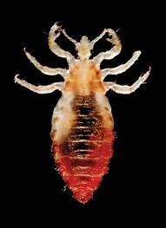
louse

Slide 172
Control
Wash and iron personal clothes daily and bed linen
Daily bath
Wash and boil infected clothes

Slide 173
Ticks
Poorly kept animals e.g dogs, sheep, may be infected with ticks
Cats and also rodents are also affected
They can cause:-
Relapsing fever
Rickettsiae diseases
Tick borne paralysis
NB:-
An infected tick with rickettsiae can pass it to its offsprings genetically

Slide 174
Control of ticks
Walls and floors to be smooth
Use effective insecticides on animals and pets
Treat the sick

Slide 175
Bed bugs
Have a life cycle of 6 weeks
Breed in cracks on the walls, floors, wood works and furniture
Mostly breed in beds
They are blood sucking insects
Produce an oily secretion with bad smell
Cause irritation and lack of sleep
Cause secondary infections
Can cause American trypanosomiasis

Slide 176
Control
Smooth floors and walls
Keep house clean
Infected furniture should be dusted with effective insecticide
Infected materials should be burnt

Slide 177
Cockroaches
Breed in cracks in warm places e.g kitchen, toilets
Come out at night mostly
They contaminate food with their excreta
Walk on utensils
They can transmit:-
Typhoid fever
Other diarrheal diseases

Slide 178
Control
Keep buildings clean
Cover all food
Destroy with insecticide
Smooth walls and floors
Proper disposal of refuse

Slide 179
Mosquitoes
Life cycle is just a few days
Eggs are laid in stagnant water
Like dark places
Female mosquito requires a blood meal to complete its cycle
They cause:-
Malaria
Filariasis (elephantiasis)
Yellow fever

Slide 180
Control
Cut grass around the compound and house
Plants and trees to be planted away from the house
Empty all tins, papers, tyres, pots or dry leaves
Ensure good lighting and ventilation
Drain stagnant water
Treat the sick
Use ITNs
Use repellants
I.R.S

Slide 181
others
Sand flies-causes kala-azar
Tsetse fly (glossina)-sleeping sickness
Itch mites
Ants and moths
These will be covered later

Slide 182
Rats and mice
Breed very frequently
Very destructive
Eat grains and vegetables
Destroy clothes, books and other items
They also transmit diseases

Slide 183
Diseases
Plague
Leishmaniasis
Relapsing fever
Typhoid fever-salmonellosis
Notes:
Visceral leishmaniasis-kala azar

Slide 184
Control
Proper refuse collection and disposal
Keep vegetation short near buildings
Move stored goods regularly
Protect food from rats and mice
Rat proof food stores
Smooth wall and floors
Improved housing
Pesticide use-
Keep cats
Traps

Slide 185
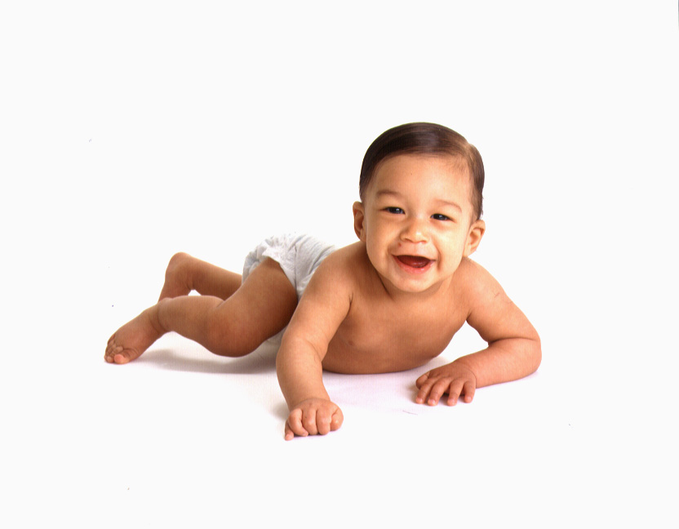
Thank You

